Slide 1
Feasibility Demo
Complex game world simulations with simple and abstracted player interaction

Slide 2
Research Question
Can pairing a complex game world with a more abstracted player interaction system make for an engaging and accessible game while preserving the depth that a complex game world usually provides?
Build a simulation game with two separate systems of player control
User test each system
Analyze the results
Notes:
This is the question my project is attempting to answer
My plan of action can be summarised in three points as

Slide 3
Annotated Bibliography
Depth vs Complexity
Article by Harkey
Simulation Games
Book chapter by Adams
Multi-Agent Systems
Paper by Marín-Lora et al
Player Experience Testing Questionnaire
Article by Wiebe et al
Modular questionnaire by IJsselstejin et al

Slide 4
Design Document & Plan
I will use Unity to build the game
I have the most experience with Unity
Easy to make a web build of the game
The design document gives a high level outline of how I will structure the game code
The design document will be updated and expanded as I continue work on the project
Notes:
Using a game engine allows me to focus on building the elements directly relevant to the research question.
I will continue to work on the design document

Slide 5
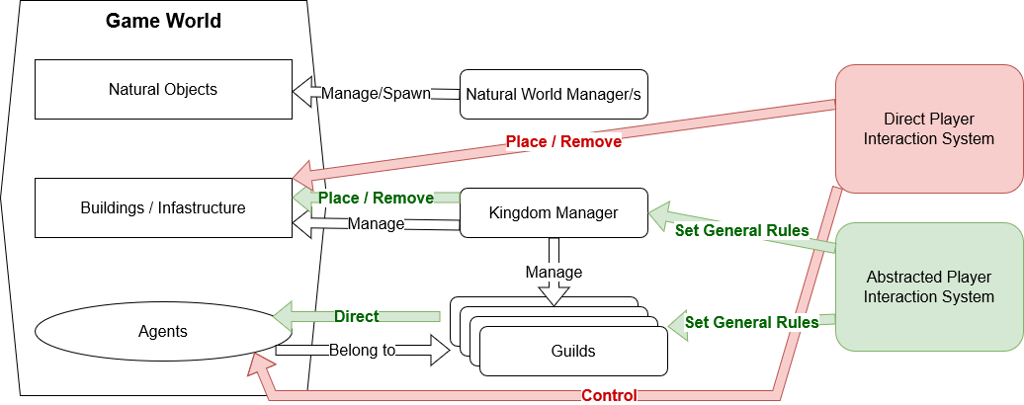
Design Document & Plan
Notes:
The is a top-level outline of the various elements of the game.
I will need to be careful to keep both player interaction systems in mind at all times when building the rest of the game.
as I will go over later I’ve already run into a situation where I unintentionally assumed that only one system would exist when building by partial prototype.

Slide 6
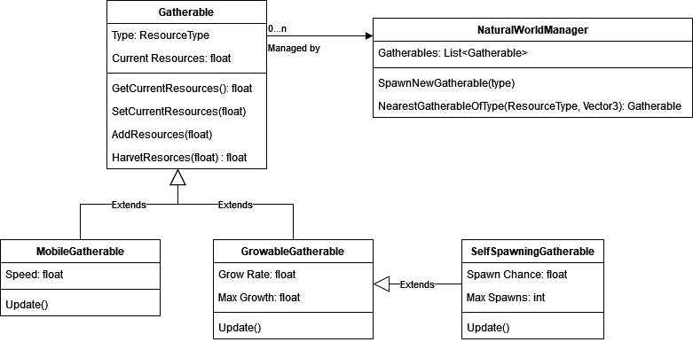
Design Document & Plan

Slide 7
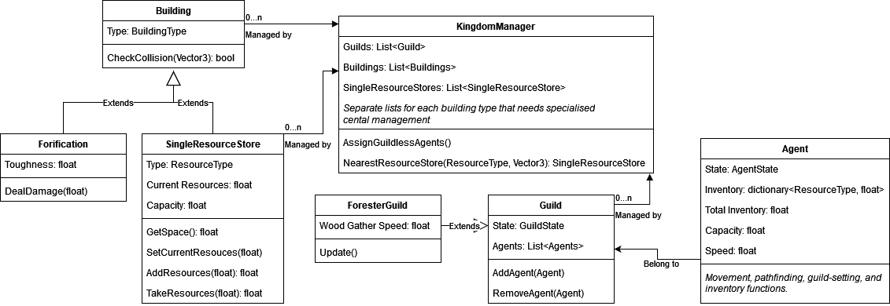
Design Document & Plan

Slide 8
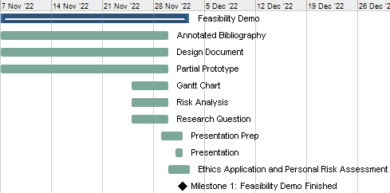
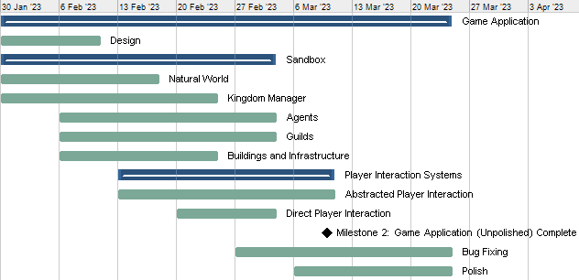
Gantt Chart

Slide 9
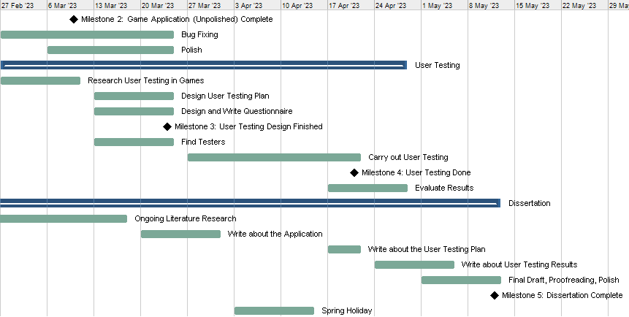
Gantt Chart

Slide 10
Move to Prototype Demo

